Slide 1

iSport
By
Oliva Gianluigi

Slide 2
Index
What is iSport
Goals
Architecture
Sequence Diagram
User Interface
Testing

Slide 3
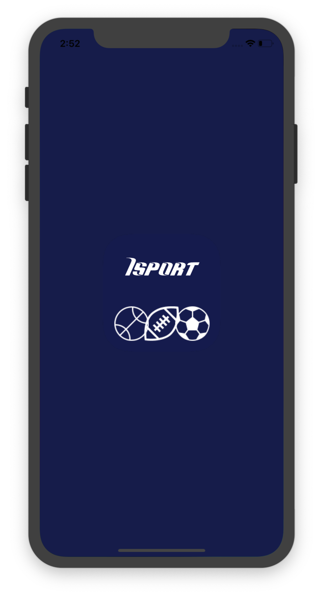
What is iSport
iSport is an app used for:
Reading news
Sharing news
Monitoring the game status
Betting
Chatting

Slide 4
Goals
News:
View daily news
Save favorite news
Share news on Facebook
Bet:
Compose your ticket
View the potential winning
Purchase ticket
Live:
View football match result
View match details
Chat:
Chat with other users

Slide 5





Architecture
Swift for development
CoreData for Database
External Services

Slide 6
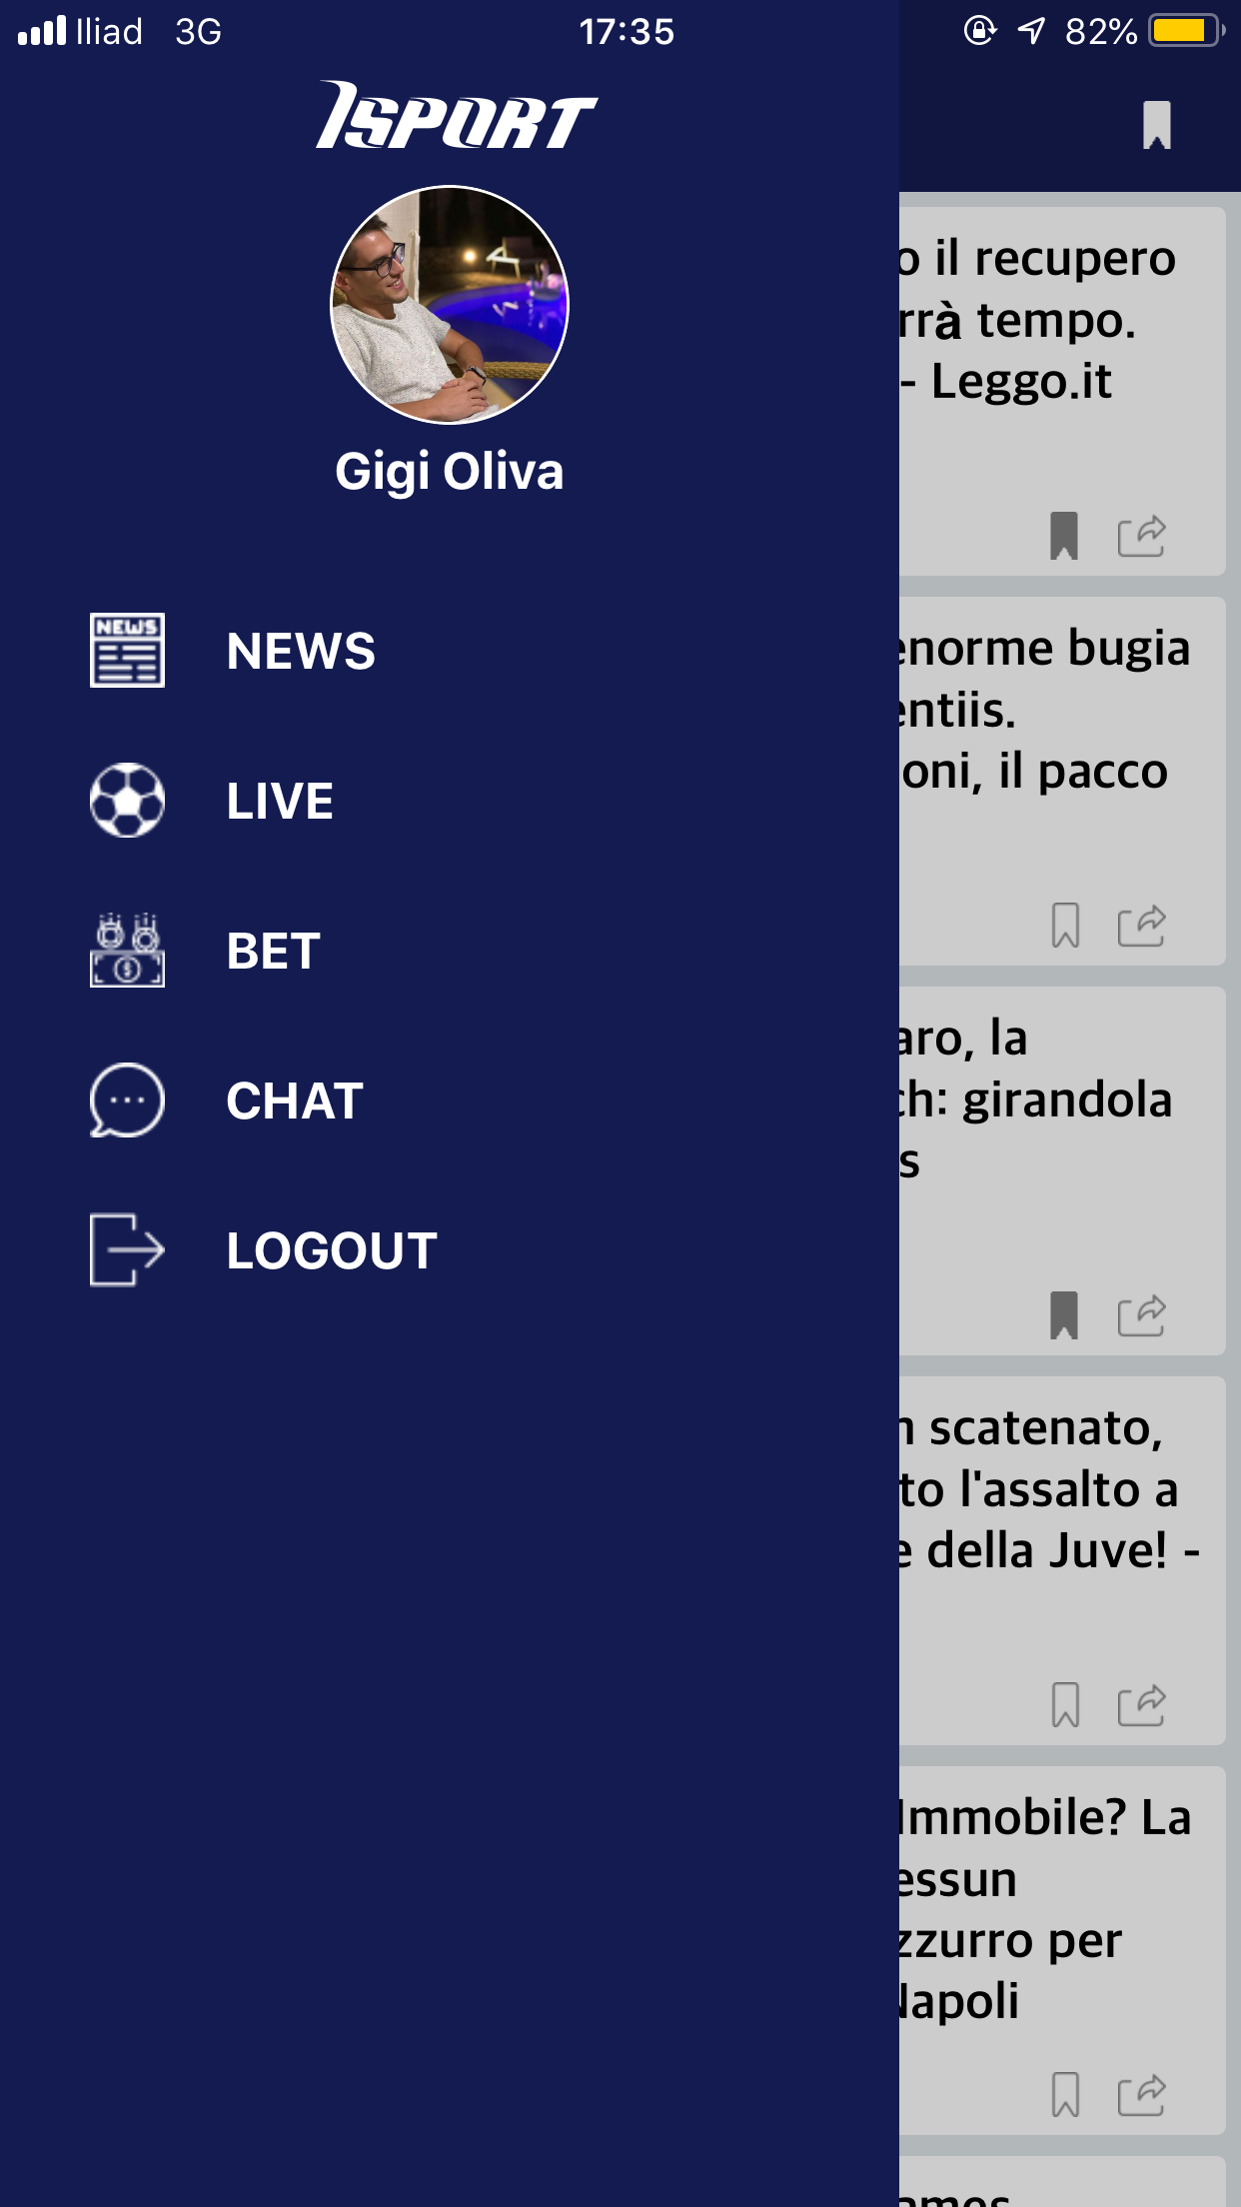
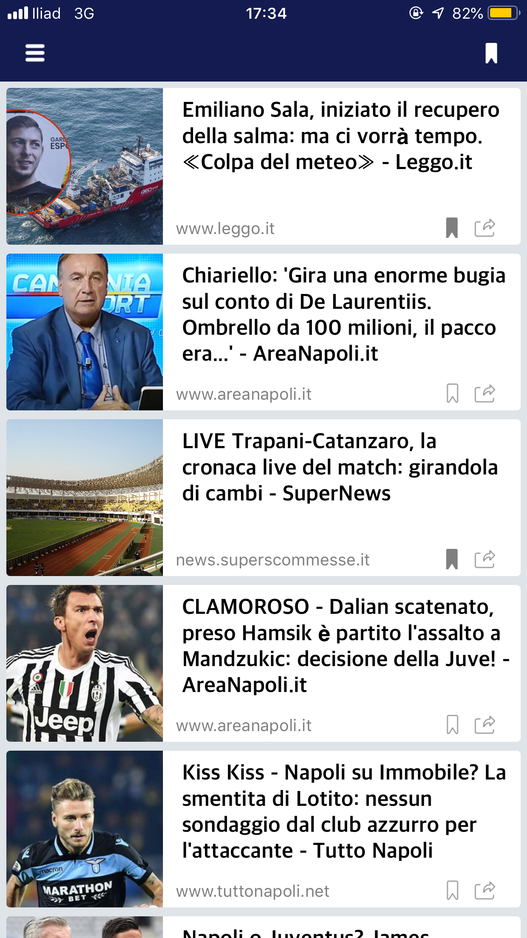
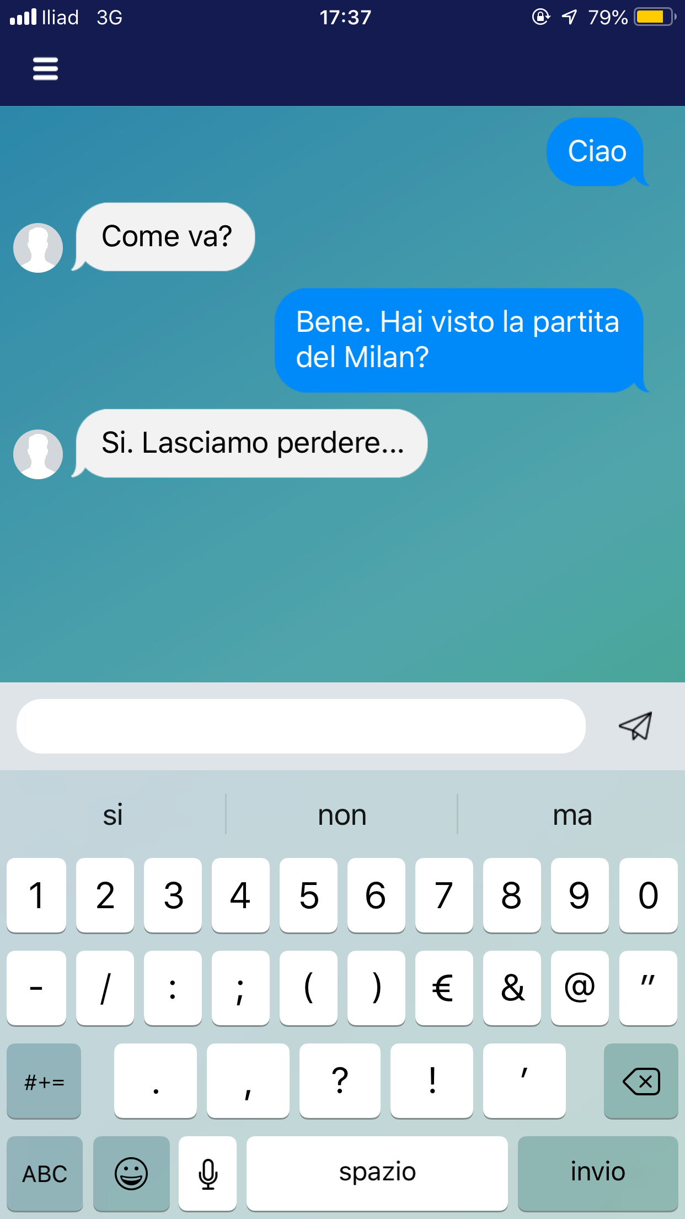
User Interface
Login
News
Chat

Slide 7
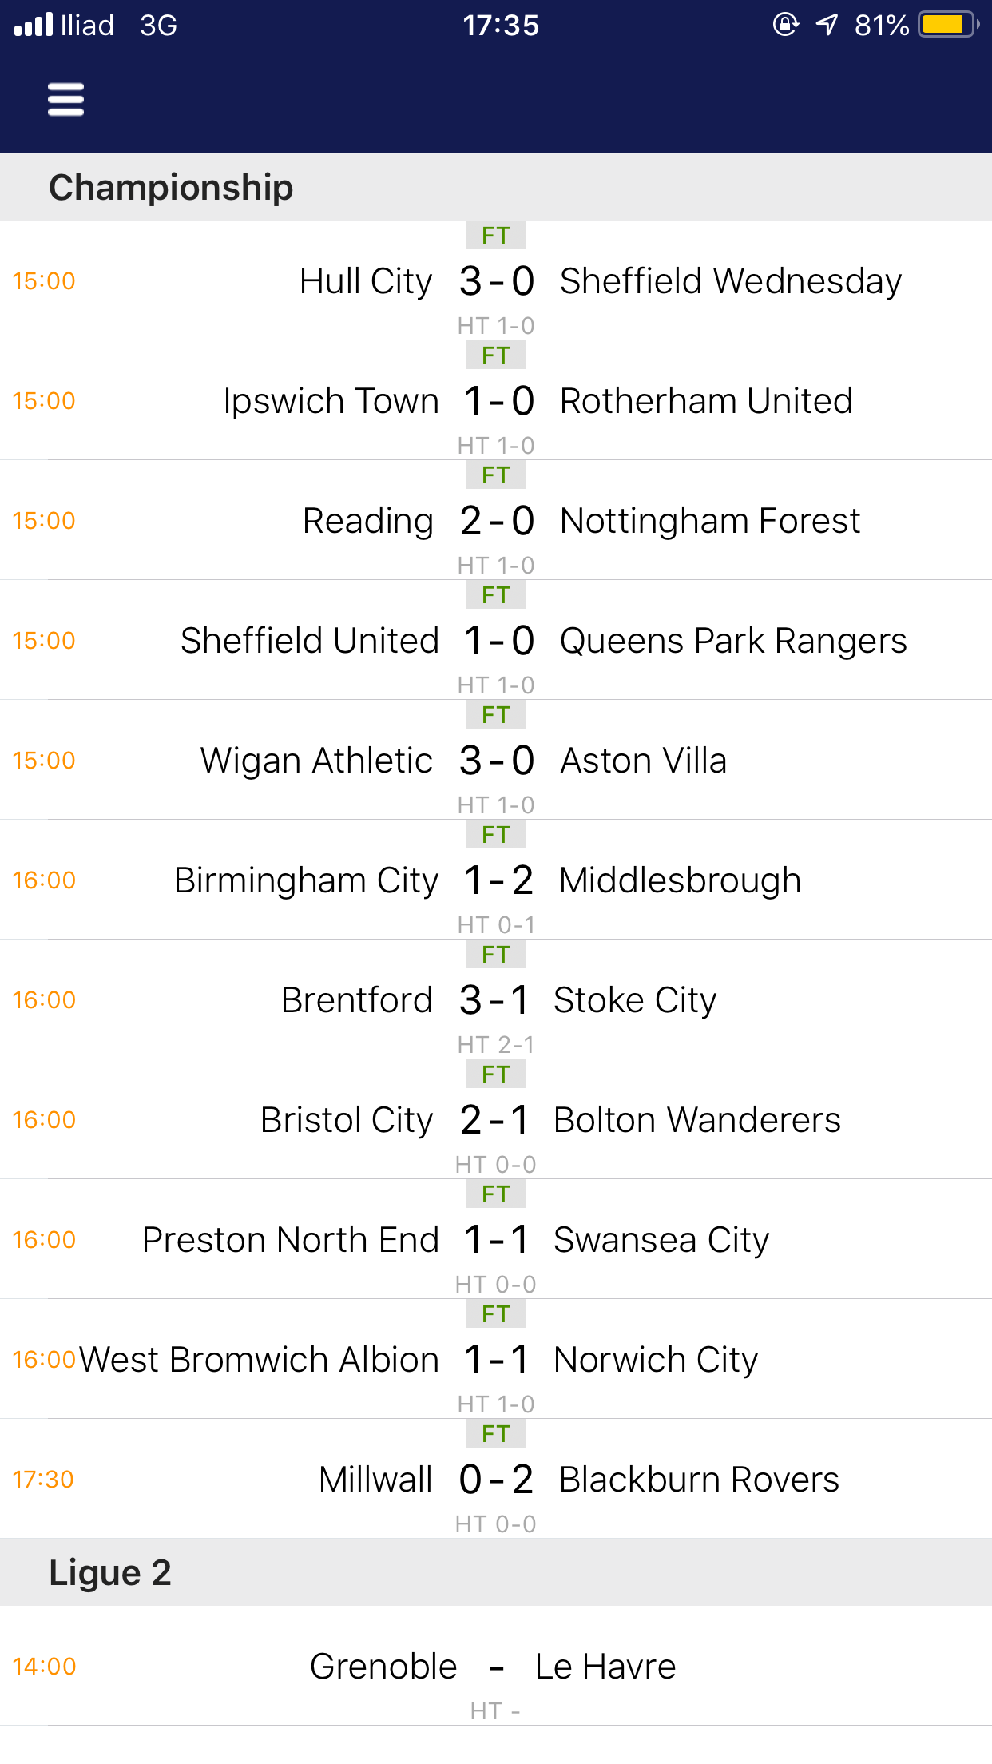
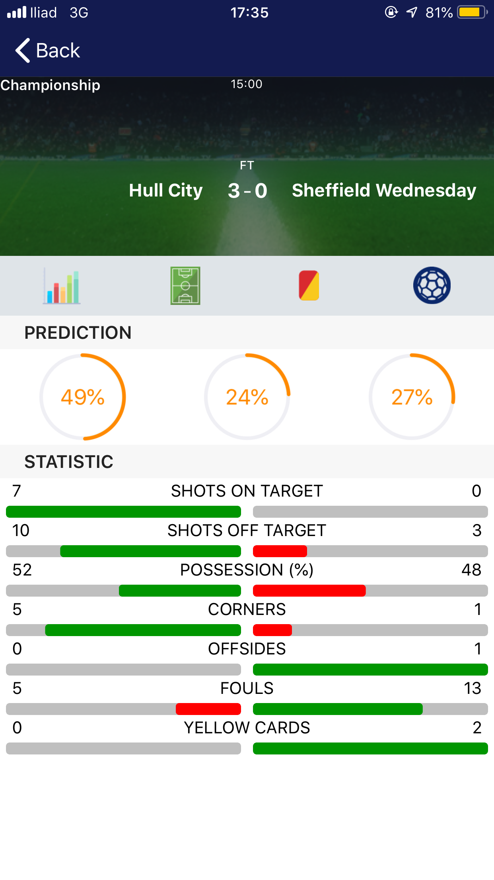
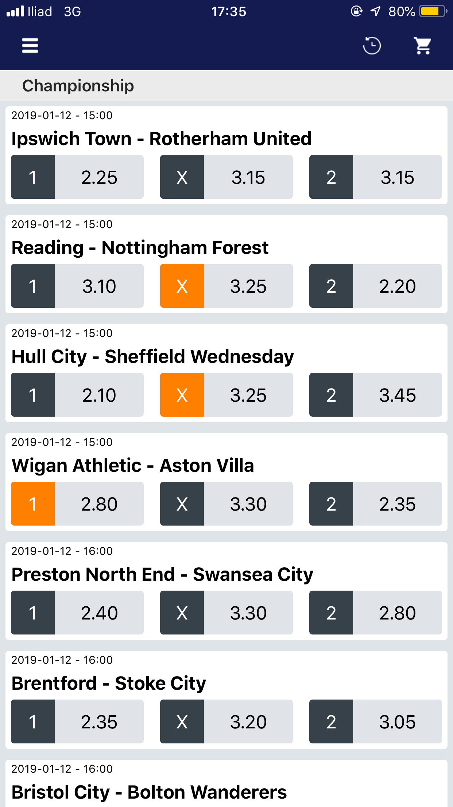
User Interface
Live
Match Details
Ticket

Slide 8
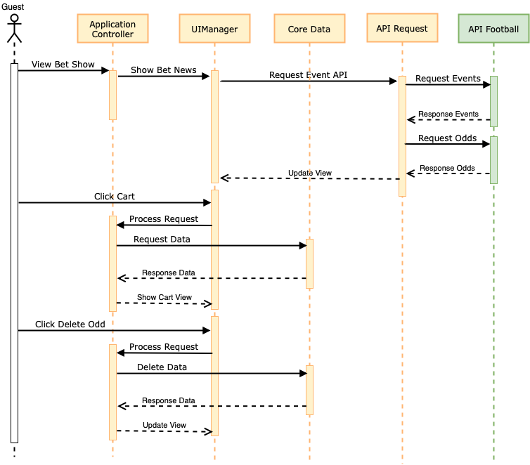
Sequence Diagram

Slide 9
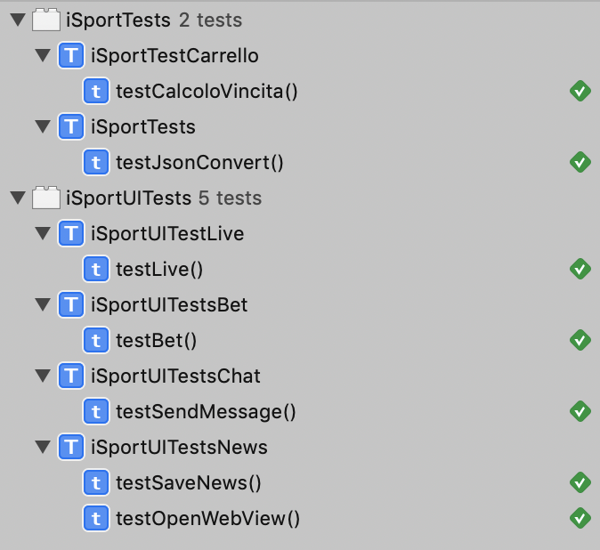
Testing

